Slide 1
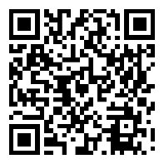
Beratung & Service für Studierende an der Uni Bayreuth
★
★ Fachstudienberatung
★ Fachschaften
Hilfe?!?
Psycho-
logische
Beratung
PULS
Studien-
support
★
★ Sozialberatung
becks
★
★ KarriereService
Zentrale
Studien-
beratung
★ Schreibzentrum
★ Studierendenkanzlei
★ Prüfungsämter
Inter-
national
Office
★ Sprachenzentrum
Servicestelle Diversity
Universitäts- bibliothek
★ Familiengerechte Hochschule
★ und viele mehr …
★
★
www.universum.uni-bayreuth.de

Slide 2
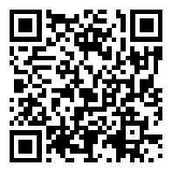
Advising & Service for Students at the University of Bayreuth
★
★
★ Programme advising
Writing Centre
Help?!?
Student
Advising
PULS
Study
Support
★
★ CareerService
becks
★
★ Language Centre
★ Student Counsils
Psychological
Counselling
★ Student Administration Office
★ Examination Offices
Inter-
national
Office
★ Social Counselling
Diversity Service Centre
★ Family-friendly University
University
Library
★ and many more …
★
★
www.uni-bayreuth.de/en/advising-service-network

